Slide 1
Quality Assurance as a culture: raising awareness on its importance
Ester Boldrini
International Project Management Office, Director
University of Alicante

Slide 2
quality culture can be enforced by structural decisions which stimulate shared values and beliefs. (Harvey & Stensaker 2008: 434)
QUALITY CULTURE: a cultural/psychological element AND structural/managerial element^{I}
Strategic management
External stakeholders
(governance/information)
Empowerment
Affective Commitment
Ownership**
Quality Culture
Vs
Quality Assurance^{II}
Institutional context and structures
European Standards and Guidelines
Staff
Committee
Students
Mapping of existing processes
Compliance
Vs
Quality
Organisational structure and processes
Quality Assurance proceses: tangible*
Audit
Vs
Continuous improvement
Notes:
https://enqa.eu/indirme/papers-and-reports/associated-reports/EUA_QA_Forum_publication.pdf
https://eua.eu/downloads/publications/examining%20quality%20culture%20part%20i%20quality%20assurance%20processes%20in%20higher%20education%20inst.pdf
EUA’s Quality Culture project (2006)
“Examining Quality Culture in European Higher Education Institutions (EQC)”
*Ehlers 2009
**https://eua.eu/downloads/publications/reinforcing%20pillars%20for%20quality%20culture%20development%20a%20path%20analytic%20model.pdf
^{I}EUA 2006, 10
https://eua.eu/downloads/publications/examining%20quality%20culture%20part%20i%20quality%20assurance%20processes%20in%20higher%20education%20inst.pdf
^{II}(EUA 2009: 13)

Slide 3
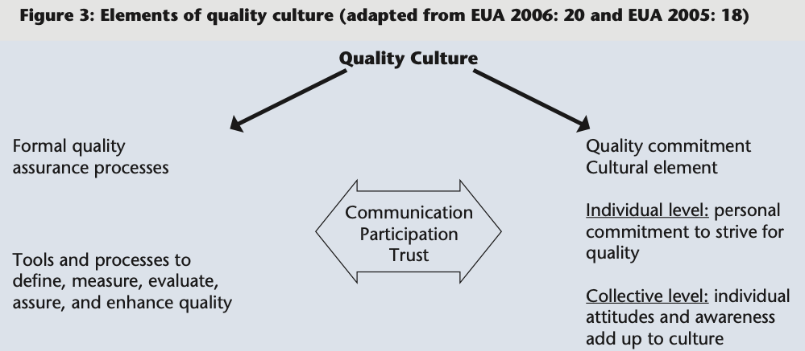
quality culture can be enforced by structural decisions which stimulate shared values and beliefs. (Harvey & Stensaker 2008: 434)
QUALITY CULTURE: a cultural/psychological element AND structural/managerial element^{I}
Strategic management
External stakeholders
(governance/information)
Empowerment
Affective Commitment
Ownership**
Quality Culture
Vs
Quality Assurance^{II}
Institutional context and structures
European Standards and Guidelines
Staff
Committee
Students
Mapping of existing processes
Compliance
Vs
Quality
Organisational structure and processes
Quality Assurance proceses: tangible*
Audit
Vs
Continuous improvement
Notes:
https://enqa.eu/indirme/papers-and-reports/associated-reports/EUA_QA_Forum_publication.pdf
https://eua.eu/downloads/publications/examining%20quality%20culture%20part%20i%20quality%20assurance%20processes%20in%20higher%20education%20inst.pdf
EUA’s Quality Culture project (2006)
“Examining Quality Culture in European Higher Education Institutions (EQC)”
*Ehlers 2009
**https://eua.eu/downloads/publications/reinforcing%20pillars%20for%20quality%20culture%20development%20a%20path%20analytic%20model.pdf
^{I}EUA 2006, 10
https://eua.eu/downloads/publications/examining%20quality%20culture%20part%20i%20quality%20assurance%20processes%20in%20higher%20education%20inst.pdf
^{II}(EUA 2009: 13)

