Slide 1
Programme Self-Evaluation
Online module
23 July 2020
Elizabeth Noonan, Director of Quality Enhancement, University College Cork

Slide 2
Welcome & Introduction
The journey, Not the destination matters
T.S Eliot

Slide 3
AIMS
Explain programme self-evaluation simply as a reflective process
Outline process of gathering and considering relevant evidence for reflection in action and reflection on action
Connect this module the the next stages of WP 5

Slide 4
Intended Outcomes
Critical understanding of the purposes of programme self-evaluation
Identify and plan for self-evaluation of your chosen programme
Appreciate the practical steps involved in managing and coordinating a process with your colleagues

Slide 5
Purposes of Programme Self-Evaluation
Primary purpose a systematic examination of how well a programme is operating in terms of its intended purpose and outcomes
The goal of self-evaluation:
What are we doing, why, how and how well on the programme?
What is the quality of the programme (e.g. content, student learning experience?
How do we know?
How can the programme be enhanced and sustained?
Who is the self? Self-reflection and self-reflective practitioners

Slide 6
The key is professional inquiry
An inquiry approach into professional practice of all the activities related to the design, delivery and operation of the programme
Evidence- base – how do you know? What data will help to illustrate what is going on?
Analysis of data to see what patterns emerge – reflection on necessary actions

Slide 7
Programme self-evaluation as part of the quality cycle
Assurance – how effectively are the key quality assurance processes which support the programme working?
Quality enhancement - what good practices are already in place, can be built upon can be shared within and wider
Action planning what priority actions does the team of staff responsible for the programme want to take
All of the above documented in report which allows on-going monitoring year on year
Holistic exercise in providing confidence to students, employers, parents, stakeholders

Slide 8
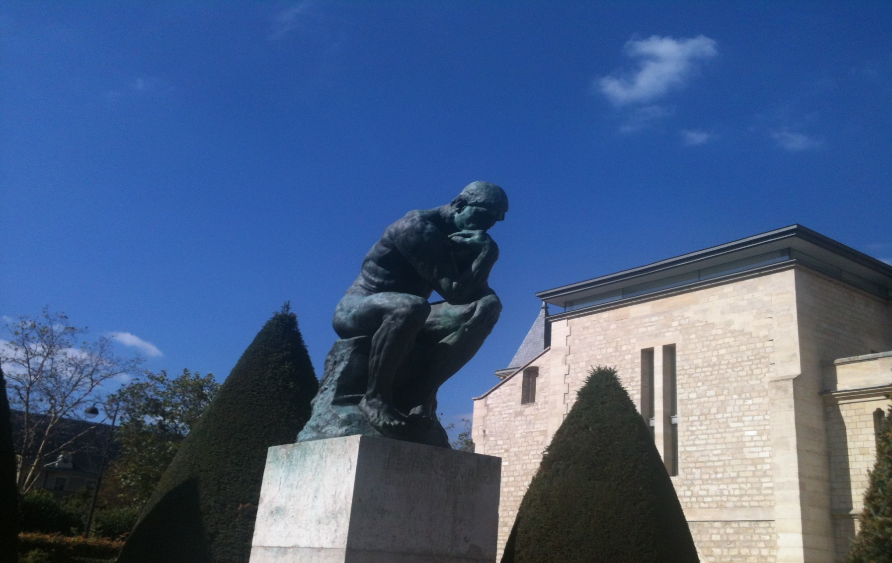
A great University has a dual function, to teach and to think
Sir William Osler

Slide 9
Main Stages of Programme Self-Evaluation:
The process of inquiry and reflection includes description and analysis of:
Programme Description and Programme Outcomes
Learners and Learning Experience
Teaching and learning, including the impact of research/scholarship on teaching
Programme Staff
Programme Governance & Quality Enhancement

Slide 10
Programme Description and Outcomes
Overall how effectively is the Programme operating in terms of the educational purpose and stated programme outcomes?
How well do the programme outcomes reflect current and emerging disciplinary knowledge?
How well do they meet the needs of learners and wider society?
How well do they fit with the institution’s overall educational strategy or educational orientation?
How well does the range of course units support achievement of the overall programme outcomes?
What evidence might be useful?
Programme Learning Outcomes and mapping of these to module learning outcomes
Programme structure and content (A table with the all the courses/units for the programme) (Full descriptions of course units in Appendix)
Graduate outcomes and destinations, and any graduate/ alumni feedback

Slide 11
Learners and learning experience
Overall how effectively are learners supported and enabled to understand and achieve the outcomes of the Programme?
What is the typical student learning experience?
What types of students enter the programme?
How well do students achieve the programme outcomes?
What is students’ perspective on their learning experience?
What is the staff perspective on the student learning experience?
What evidence might be useful?
Student data: gender, admission standards, progress to graduation, performance (pass/fail/honours)
Student feedback on their learning experience (many ways of gaining this info)
Staff dialogue and review of student performance

Slide 12
Teaching and learning & impact of research/scholarship
What processes are in place to ensure that the teaching, learning and assessment approaches are appropriate for the intended programme outcomes, programme content, intended learning experience and diversity of learners?
What is the overall effectiveness of the learning, teaching and assessment approaches?
How well does assessment support learning and students’ engagement with the programme material?
How well does assessment verify that learning has taken place?
How does assessment approach encourage the development of skills and competence as well as knowledge?
What evidence might be useful?
A philosophy or statement of teaching, learning and assessment approach
An assessment matrix which shows all the forms of assessment in use
What disciplinary or pedagogic research and scholarship is influencing the programme
What learning resources are available to students?

Slide 13
Programme Staff
What is the range of staff skills and experience supporting the programme?
What processes are in place to develop and enhance staff skills, expertise and scholarly activities in the delivery of the programme?
How do staff feedback and communication mechanisms enable the ongoing programme delivery and development, (e.g informal/formal dialogue about teaching, peer review of teaching, regular meetings about the programme)
What evidence might be useful?
A profile of the staff teaching on the programme including details of experience, qualifications
Examples of staff meetings, professional development, achievements and recognition
Plans and priorities for staff development, or examples of academic innovations implemented

Slide 14
Programme Governance & Quality Enhancement
What processes are in place for planning, monitoring, and developing the programme?
Is there an established programme team and an approach to programme management?
How frequently does it meet?
How are students involved/engaged as part of the programme governance & qa/qe processes?
How does the programme compare itself to similar programmes elsewhere (benchmarking), or what useful benchmarking activity might help to enhance aspects of the programme further?
Overall, how do the processes for programme management support qa/qe
What evidence might be useful?
Details of the programme management structure
Remit and responsibilities of key personnel
Reporting arrangements to the Rector, to Faculty, to Senate
Samples of action plans
Samples of programme management agendas and follow- up activities

Slide 15
Taking the plunge and getting started!
Notes:
Please take 5 minutes to write down a specific question that you have about programme self-evaluation that you wish this training to address

Slide 16
Some Practical Considerations
Who will take a leadership role?
What are the specific goals of your self-evaluation – state them! What is the focus of your inquiry?
How to set direction? - SWOT analysis
How will all staff be engaged in the process of self-evaluation?
Consider what data is practical and accessible?
Consider what data needs to be gathered because it will add value
Make a plan with milestones

Slide 17
Some Practical Considerations
The end-point – what does it look like?
The Programme Self-Evaluation Report:
A short analytical document ( 12-15 pages with Appendices) which describes and analyses the strengths and areas for further development of the programme
Details the process of inquiry and evidence-based reflection
Outlines the Action Plan for enhancement of the programme: e.g could include decision to regularly collect particular forms of data; to change assessment methods; improve resources; implement new teaching approaches; staff development etc.

Slide 18
OUTLINE OF WORK PLAN: 4 Stage Approach to Project:
Establish the basics for Programme Self-Evaluation
(now to March 2020)
Initial steps in Programme Self-Evaluation
(March – September,2020)
Beginning Progamme Self-Evaluation
(October – April 2021)
External Evaluation Event (June – August 2021)

Slide 19
3. Begin Programme Self-Evaluation: October 2020 onwards
Haitian Partners will: Produce an early draft/outline of their Programme Self-Evaluation by 20th November 2020 and a further draft by mid- February 2021
UCC will: Review drafts and provide commentary to inform the next versión
Both parties will: work together to achieve effective Programme Self-Evaluation Reports which will be finalised by April 2021.
UCC will: Identify the European external experts to conduct External Evaluation

Slide 20
Elizabeth Noonan
University College Cork
Elizabeth.Noonan@ucc.ie
Notes:
Please take 5 minutes to write down a specific question that you have about programme self-evaluation that you wish this training to address

